Slide 1

Comprehensive Introduction to Python Programming: Welcome & Introductions
Kevin Cunningham

Slide 2
Introductions
Course Instructor
Kevin Cunningham
Course attendees
You…
What’s your role/team?
Python / Programming experience
Motivation and Expectations

Slide 3
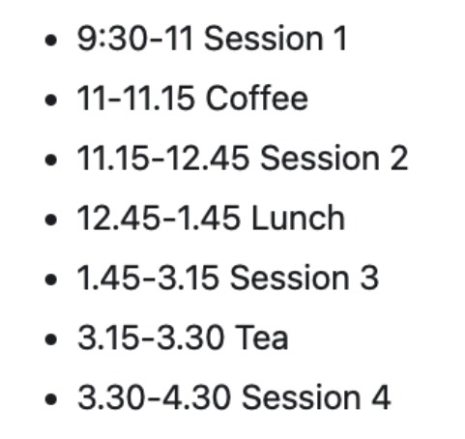
When do get coffee?

Slide 4
Course Content
Course objectives
Learn core aspects of the Python language
On this course we are looking at:
What Python is and the make-up of the Python environment
Python Syntax, Types & Flow of control
Python Functions and Higher Order functions
Object Oriented Programming in Python
Operators
Python Modules
Testing in Python
Files and Error Handling

Slide 5
Questions?
?

